Slide 1

Connected Operations (COps) Platform
Team 32: Caleb Boswell, Spencer Yoder (Presenters), Jonathan Balliet, Daniel Mills, Jeen Shaji
Notes:
Phrases:
Project Recap
Requirements/constraints (demo)
Design
Low-Level discussion:
- Should be very SELinux-focused
Conclusion
Summary of Session with Ms. Heil:
We should go with this design for the presentation
Our presentation should be broken up to the sections (phrases) defined above
We should include some of the slides in the OPR 4 draft:
The slide detailing how users interact with use cases in CourseManager
Something similar to our testing progress (probably broken up over multiple slides)
Something similar to the SELinux Policy module code slide
At a high level, we should do the recap, go over requirements/constraints (for the current iteration), take a deep dive into our current progress, go over testing, and then conclude the presentation
For the deep dive, we should talk primarily about how we’ve integrated with SELinux, this will include how we’ve developed the policy and also how we’ve modified CourseManager/container runtime to interact with this policy. This will also be where our challenges will go.
We should be current-system-focused. E.g.
We no longer have the requirement to read in data from multiple stores
We’ve added the front-end as a requirement
etc.
I took some notes from the presentation and put them in the other slides

Slide 2
Content
Project Recap
Requirements/Constraints
Demo
High-Level Design
Low-Level Design: Integration with SELinux
Testing
Conclusion/Action Steps

Slide 3







Project Recap
Sponsor Background
Skyward Federal creates custom, secure software solutions for government clients
Infrastructure as Code
Cloud Migration
App Development
Data Security
DevSecOps
U.S. Air Force

Slide 4
Project Recap
Problem Definition:
Multi-level data storage is difficult to do securely without having separate data stores
Machine 1
(Top Secret)
DB1
Communication Overhead
Machine 2 (Secret)
DB2
Machine 3 (Confidential)
Difficult to develop across multiple systems
System failure affects data access
DB3

Slide 5
Project Recap
Proposed Solution: COps
A centralized, virtualized, multi-level data storage platform
DB1
DB2
Data Access
Top Secret
Secret
DB3
Confidential
Data Access
Public Trust
DB
Unclassified
Notes:
An example scenario could be a good addition

Slide 6
Project Recap
Requirements - Security
Data stored in the database shall be given an SELinux label specifying its SELinux data type
Users of the system shall be given an SELinux user type
Requests by a user to access/modify data shall be fulfilled or denied by SELinux based on their respective SELinux labels
Notes:
For overall requirements, they should be updated, we are working with a different system than the one described in the initial assignment
We should be current-work-focused
We need to talk about CourseManager as well as SELinux, the 3-users slide and a high-level SELinux overview will be especially helpful. No need to bring up previous work

Slide 7
Project Recap
Requirements: CourseManager
Use Case 3: Coordinators can add and delete courses from the database and enroll students in existing courses.
System allows the user to add or delete a course based on their input
Notes:
Replace with info on what class does from frontend perspective

Slide 8
Project Recap
Requirements - Course Manager
3 Users: Coordinator, Instructor and Student
 | UC 1 | UC 2 | UC 3 | UC 4 | UC 5 | UC 6 | UC 7
 | Login | View Account | Edit Course | Edit User | Edit Grade | View Schedule | View Logs
Coordinator
Instructor
Student
Notes:
UC 1, 2, and 4 were previously completed
UC 3, 5, and 6 are now completed (if we get done in time)
For our mock system called Course Manager, we have 3 users: Coordinators, Instructors and Students.
We have a total of 7 use cases. All of which can be done by the coordinator.
We see see that an instructor can do 4 of these while a student has limited access.
We currently have UC1, 2 and 4 completed. We will see this in the demo later

Slide 9
Project Recap
Constraints
SELinux shall be used as our security module to enable Multi-Level Security (MLS) with our database
System shall run on CentOS 7 with SELinux enabled
PostgreSQL shall be used as our database
Docker Containers shall be used to run RESTful services
SELinux label (i.e. Authorization Level) of the user shall be enforced on running services
Notes:
CentOS 7 is used to its easy integration with SELinux
PostgreSQL is used due to an extension that allows its columns and tables to be labeled with SELinux
Docker allows isolation of running services (improves security)
Labeling the Docker Container’s IP connection with SELinux enforces what the user can and cannot due in this running service

Slide 10
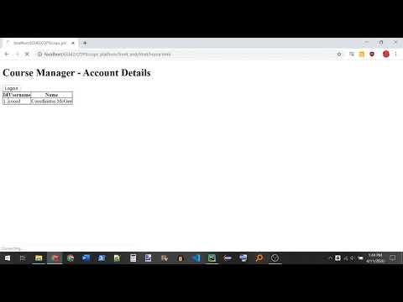
Demo (Front-end)
Notes:
Integration (maybe backend demo), Frontend demo
“We showed this to our sponsor and they just loved it”

Slide 11
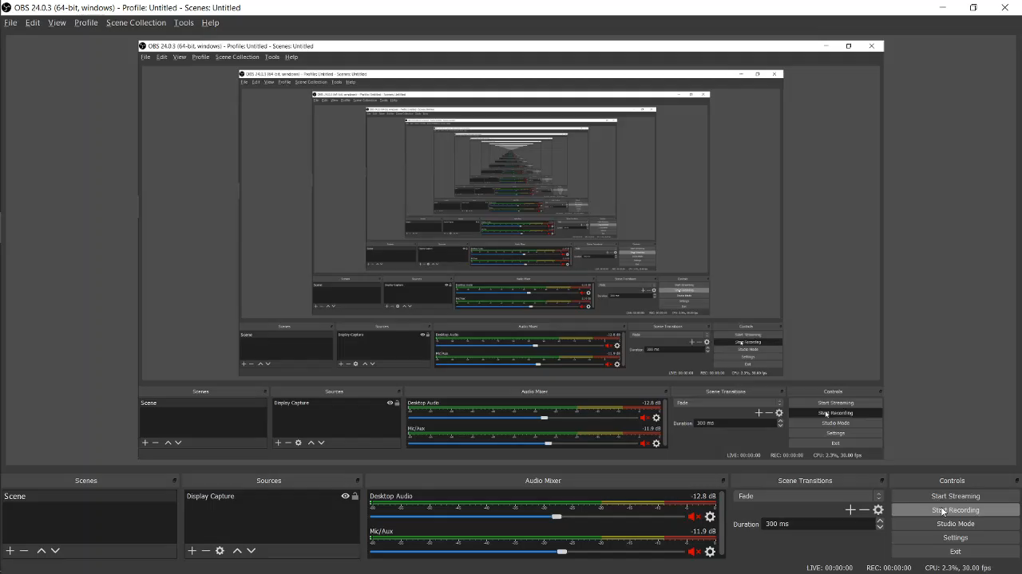
Demo (Back-end)
Notes:
I will create a backend demo showing those curl commands which are allowed and denied by SELinux

Slide 12










Project Recap
High-Level design
Service Request
User
CourseManager
RESTful service
SQL Query
REST Request
Spencer Yoder
JSON response
Caleb Boswell, Jeen Shaji,
Jonathan Balliet
Data
Daniel Mills
Jonathan Balliet
Daniel Mills, Spencer Yoder
Notes:
Add animations to highlight new elements, emphasize front-end and SELinux integration progress, animate series of interactions
Return to this diagram in-between discussions of low-level designs

Slide 13









Low-Level Design
Integration with SELinux
Service Request
User
CourseManager
RESTful service
SQL Query
REST Request
Spencer Yoder
JSON response
Caleb Boswell, Jeen Shaji,
Jonathan Balliet
Data
Daniel Mills
Jonathan Balliet
Daniel Mills, Spencer Yoder
Notes:
I will recolor the rest of the pictures when I put this back on powerpoint

Slide 14
Integration with SELinux
Overview
SELinux is a Linux kernel module which provides Mandatory Access Control (MAC) through type enforcement
Every aspect of the system gets labeled with a security context
Actions are allowed through access vector rules
Subject
My Process
system_u:process_r:my_process_t:s0
allow my_process_t my_file_t:file {read};
My File
system_u:object_r:my_file_t:s0
✔
Controlled access
My Process
My File
My User
system_u:user_r:my_user_t:s0
read
Object
Notes:
Define MAC, policy, type enforcement

Slide 15
Integration with SELinux
Our Proposed Policy
3 User types
coordinator_t, instructor_t, student_t
5 Data Types
coordinator_data_t, instructor_data_t, student_data_t, course_data_t, grade_data_t
 | coordinator_t | instructor_t | student_t
Can read | Everything | instructor_data_t course_data_t grade_data_t | student_data_t course_data_t grade_data_t
Can write | Everything | grade_data_t | Nothing
Notes:
Define MAC, policy, type enforcement

Slide 16
Integration with SELinux
Challenges With Integration:
Where do we put our labels?
It’s hard to give a process a different label when launched under identical conditions.
Parent Process
Parent Process 1
Parent Process 2
Parent Process 3
This cannot happen in SELinux
One of three labels
This can, but there’s no room for this pattern in our design
CourseManager
CourseManager

Slide 17
Integration with SELinux
Solution:
The containers
Each container, before it launches CourseManager, knows the role of its user
Container 1
Container 2
Container 3
CourseManager

Slide 18
Integration with SELinux
Attempted Implementation #1
There is a way to label Docker containers…
But it wouldn’t work on our computers
Container 1
label
Container 2
label
Container 3
label
CourseManager

Slide 19
Integration with SELinux
Attempted Implementation #2
There is a way to label IP addresses.
Each container has a unique IP address.
Container 1
CourseManager
IP 1
label
Postgres Server
Postgres IP
Container 2
CourseManager
IP 2
label

Slide 20
Integration with SELinux
Implementation #2 Works!
Our solution is a little cobbled-together, but it correctly labels database accesses based on the user type
Postgres Server
Start up
Container
REST request
Container Runtime
CourseManager
IP
Get IP
Label IP
IP labeling script

Slide 21
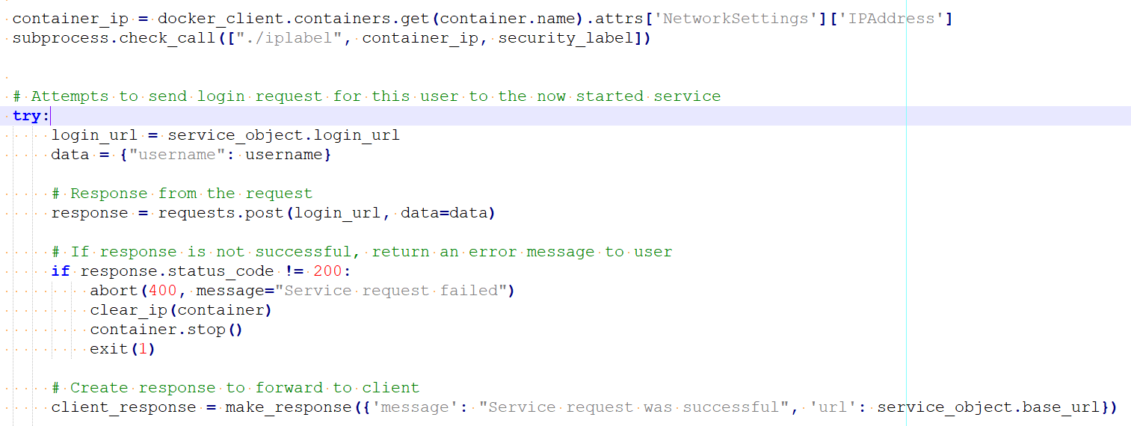
Integration with SELinux
Code (Container Runtime)
Label the IP
Send a response after the IP has been labeled and the service is running

Slide 22
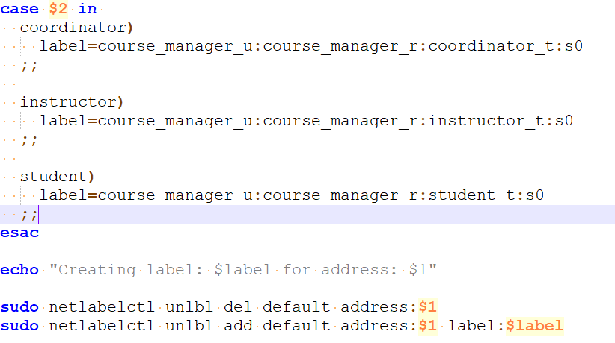
Integration with SELinux
Code (IP Labeler)
Get the label based on the user type passed in as a parameter
Label the given address with said label

Slide 23
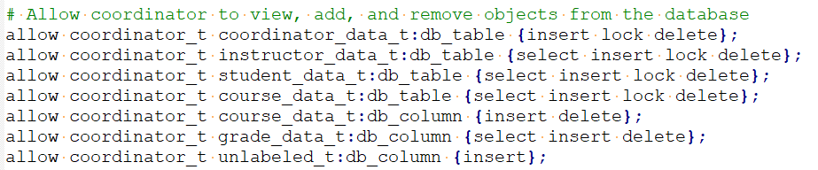
Integration with SELinux
Code (SELinux Security Policy Module)
Allow coordinators to insert into unlabeled database columns

Slide 24
Testing
Unit Testing
Completed for UCs 1 - 4, 6
Using Python’s unittest tools
Tests have been written for remaining use cases but those use cases are not completed
Coverage (coverage.py):
Course Manager - 94 %
Container Runtime - 80 %
Notes:
-***JB notes***
- Will need to update Testing section based on what we accomplished. Just putting what I feel we can get done here.
- Right now our black box/system testing is done via CURL commands, eventually would like to incorporate with the front-end if we can get done in time.
- “Remaining tests in progress”: Need to create the selinux policies for student and instructor that support their level of access for thees UCs
If there are things we are unable to do, we should go over them and why
E.g. We cannot do system testing yet, our front-end was only recently formalized and our system was only recently integrated

Slide 25
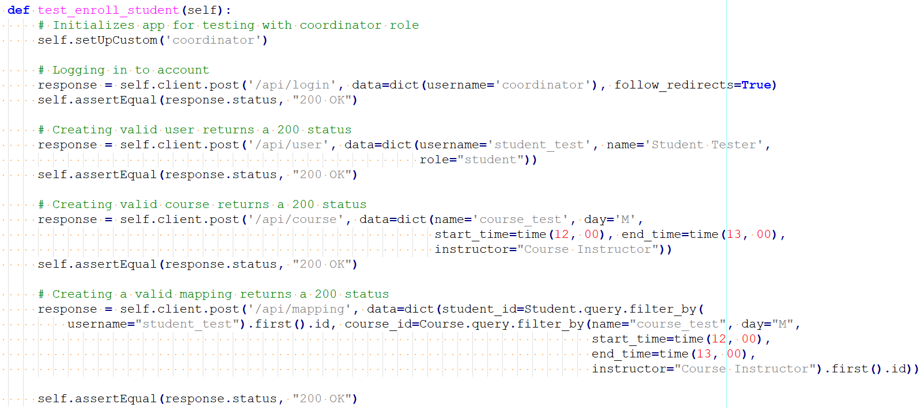
Testing
Unit Testing
Notes:
-***JB notes***
- Will need to update Testing section based on what we accomplished. Just putting what I feel we can get done here.
- Right now our black box/system testing is done via CURL commands, eventually would like to incorporate with the front-end if we can get done in time.
- “Remaining tests in progress”: Need to create the selinux policies for student and instructor that support their level of access for thees UCs
If there are things we are unable to do, we should go over them and why
E.g. We cannot do system testing yet, our front-end was only recently formalized and our system was only recently integrated

Slide 26
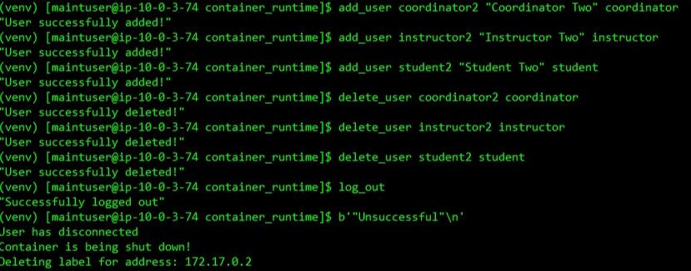
Testing
System Testing
Completed for UCs 1, 2, 4
Using curl commands in combination with bash functions
Once the front-end is integrated with the system, further tests will be done with that interface
Notes:
-***JB notes***
- Will need to update Testing section based on what we accomplished. Just putting what I feel we can get done here.
- Right now our black box/system testing is done via CURL commands, eventually would like to incorporate with the front-end if we can get done in time.
- “Remaining tests in progress”: Need to create the selinux policies for student and instructor that support their level of access for thees UCs
If there are things we are unable to do, we should go over them and why
E.g. We cannot do system testing yet, our front-end was only recently formalized and our system was only recently integrated

Slide 27
Conclusion
This iteration we accomplished a lot!
Installed Course Manager and Container Runtime on development machines and created installation guides
Coded SELinux policies and began integration with database and the Container Runtime
Completed Course Manager use cases 3, 5, and 6
Designed front-end interface and began integrating with back-end
Need to finish integrating everything together and complete all of our system tests
Notes:
Mention action steps

